Slide 1
http://www.youtube.com/watch?v=JQVfsY0-ZR0&feature=related
This video shows us one’s dependency on substances

Slide 2
Drugs and Addictive Substances
MARK PALUCCI
CAS100A Effective Speech Communication
Penn State Hazleton
Oct 10,2011

Slide 3
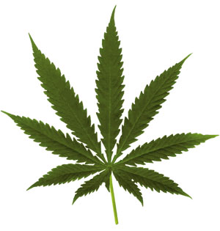
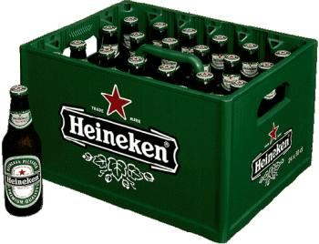
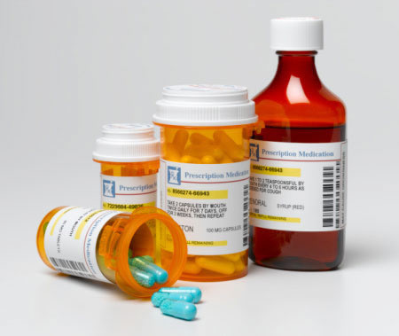
OVERVIEW
I just want to touch on three basic information:
ADDICTION TO NON-PRESPRCIPTION DRUGS
ADDICTION TO PRESCRIPTION DRUGS
ADDICTION TO TWO SUBSTANCES
Google.com/images
Google.com/images
Google.com/images

Slide 4
Main Point 1
ADDICTION TO NON-PRESPRCIPTION DRUGS
Or illegal Drugs
Google.com/images
Google.com/images
Google.com/images

Slide 5
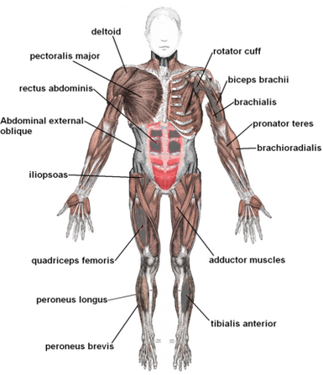
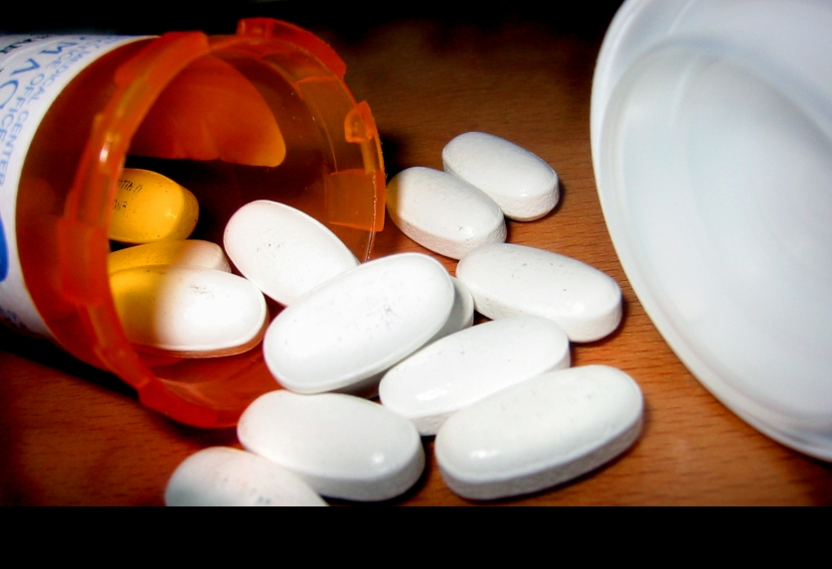
First what is a DRUG?
According to sciencemuseum.org
A drug is any chemical you take that affects the way your body works.
Drugs do not only include illegal substances, they also include prescription drugs as well.
Google.com/images
Google.com/images
Notes:
http://www.sciencemuseum.org.uk/WhoAmI/FindOutMore/Yourbrain/Howdodrugsaffectyourbrain/Whatisadrug.aspx

Slide 6
ADDICTING NON-PRESPRCIPTION DRUGS
(illegal Drugs)
Crack: is cocaine in its most raw form. Crack is a rock crystal that is heated and the vapors inhaled. The name “crack” comes from the crackling sound one hears when the rock crystal is being heated.
Heroin: is highly addictive drug; a potent substance extracted from the seed pod of poppy plants. Known on the street as black tar, heroin is usually injected and can lead to the worst addictive drug because it can be cut with other drugs such as crack and cocaine;
Marijuana: The most comm. Illegal drug, marijuana or ganja is a dry, shredded mix of flowers, stems, seeds, and leaves of from the naturally grown Cannabis sativa. Though it is addictive is does have neurotic effects that can quickly damage the brain.
MDMA (Ecstasy): A terrible drug that is synthetic and psychoactive dedicated to creating a hallucinogenic fervor. Acting as a stimuli and psychedelic Ecstasy creates an energy effect and creates distortions in reality, time and perception of the taker and ultimately creates a seemingly joyful experience.
(effectsofdrugs.info, 2007)
Notes:
http://www.effectsofdrugs.info/2007/11/12/list-of-illegal-drugs/

Slide 7
Main Point 2
ADDICTION TO PRESPRCIPTION DRUGS
Google.com/images
Google.com/images
Google.com/images

Slide 8
treatantidrug.com gives a list of painkiller substances as follows:
Opium: from the opium poppy, formerly used in medicine to soothe pain but is now often replaced by derivative alkaloids (as morphine or codeine) or man-made substitutes (opioids).
Morphine: the powerful, active ingredient of opium is used as a painkiller and sedative
Codeine: like morphine, this is found in opium and is used especially as a painkiller.
Fentanyl (and fentanyl analogs): a man-made opioid painkiller similar to morphine that is administered as a skin patch or orally.
Hydrocodone: often combined with acetaminophen for use as a painkiller. Vicodin is an example.
Oxycodone: a narcotic painkiller, for example OxyContin, Percocet, and Percodan
Notes:
http://www.theantidrug.com/drug-information/otc-prescription-drug-abuse/prescription-drug-rx-abuse/painkillers.aspx

Slide 9
The treatantidrug.com mentions pain killers as among the addictive prescription drugs.
Painkillers or Opioids are drugs that contain opium.
They are prescribed for pain relief.
Most opioid or painkilling drugs are non-refillable and, when used properly under a medical doctor's supervision, are safe and effective.
Opioid drugs act by effectively changing the way a person experiences pain.
Notes:
http://www.theantidrug.com/drug-information/otc-prescription-drug-abuse/prescription-drug-rx-abuse/painkillers.aspx

Slide 10
Main Point 3
OTHER ADDICTIVE SUBSTANCES
Google.com/images
Google.com/images
Google.com/images

Slide 11
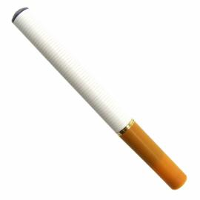
NICOTINE
in cigarettes
Google.com/images
ALCOHOL
in some beverages
http://addictionrecoverybasics.com/am-i-stupid-or-is-this-list-of-the-18-most-addictive-drugs-all-mixed-up/

Slide 12
Summary
I have presented that there is
ADDICTION from NON- PRESPRCIPTION DRUGS
and from PRESCRIPTION DRUGS
There is also an
ADDICTION TO TWO MAJOR SUBSTANCES
Let’s see if we can remember…

Slide 13
CONCLUDING THOUGHT
Even drugs or drinks or recreational things like cigarettes can have addicting substances.

Slide 14
Q&A
MARK PALUCCI
MRP5257@psu.edu

Slide 15
References
Pictures from
google.com images and from media photobucket.com
Cited Information from
http://www.sciencemuseum.org.uk/WhoAmI/FindOutMore/Yourbrain/Howdodrugsaffe
ctyourbrain/Whatisadrug.aspx
http://addictionrecoverybasics.com/am-i-stupid-or-is-this-list-of-the-18-most-addictive-drugs-all-mixed-up/
http://www.theantidrug.com/drug-information/otc-prescription-drug-abuse/prescription-drug-rx-abuse/painkillers.aspx

