Slide 1
MARK PALUCCI
”Change your thoughts and you change your world. ”
Norman Vincent Peale
http://www.brainyquote.com/quotes/topics/topic_inspirational.html

Slide 2
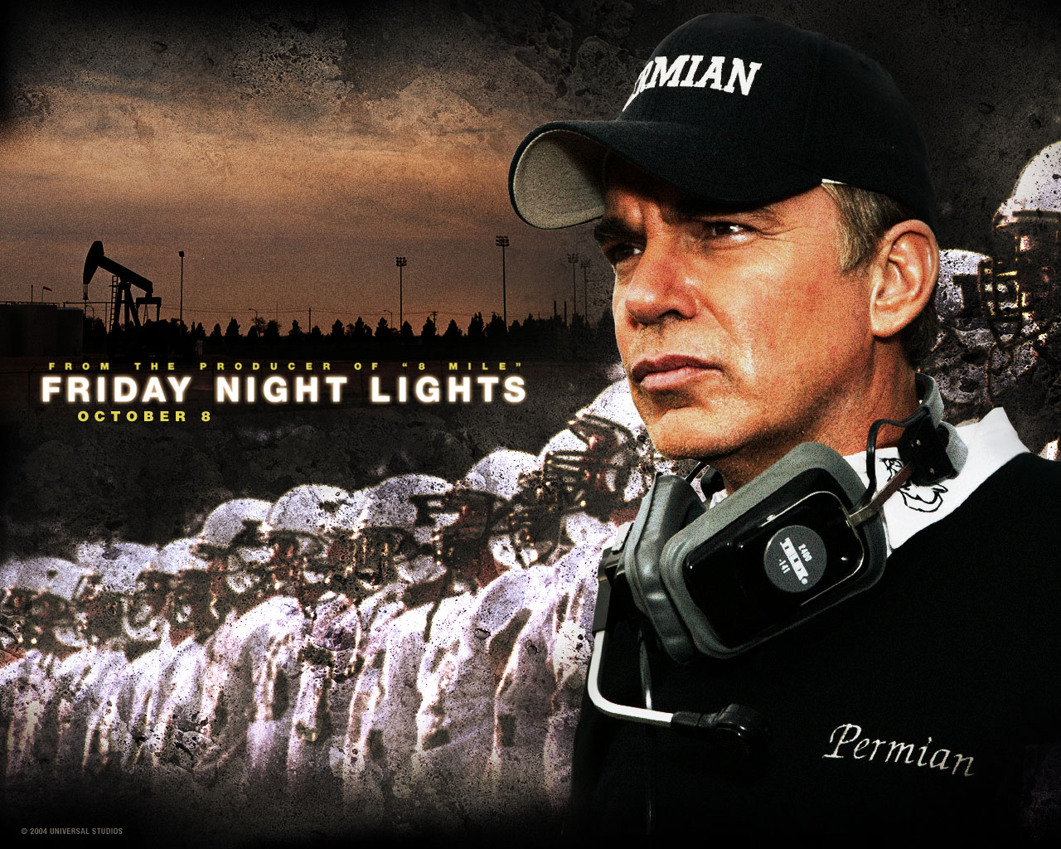
BEING PERFECT
My interpretive speech is from the 2004 film Friday Night Lights. The speech is said at half time during the state championship game. It is said by the Permian Panthers football Coach Gaines, played by actor Billy Bob Thornton.
Google.com/images

Slide 3
Well it's real simple: You got two more quarters and that's it.
Now most of you have been playin' this game for ten years. And you got two more quarters and after that most of you will never play this game again as long as you live. Now, ya'll have known me for awhile, and for a long time now you've been hearin' me talk about being perfect.
Well I want you to understand somethin'. To me, being perfect is not about that scoreboard out there. It's not about winning. It's about you and your relationship to yourself and your family and your friends.
Being perfect is about being able to look your friends in the eye and know that you didn't let them down, because you told them the truth. And that truth is that you did everything that you could. There wasn't one more thing that you could've done.
Can you live in that moment, as best you can, with clear eyes and love in your heart? With joy in your heart?
If you can do that gentlemen, then you're perfect.

Slide 4
Sources
Friday Night Lights Directed by Peter Berg, Produced by Brian Grazer,
Written by H.G. Bissinger (book), David Aaron Cohen and Peter Berg
Released in 2004 by Imagine Entertainment Studios
Picture of Coach Gaines and players from Google.com/images
Quote from Norman Vincent Peale retrieved from
http://www.brainyquote.com/quotes/topics/topic_inspirational.html

